Slide 1

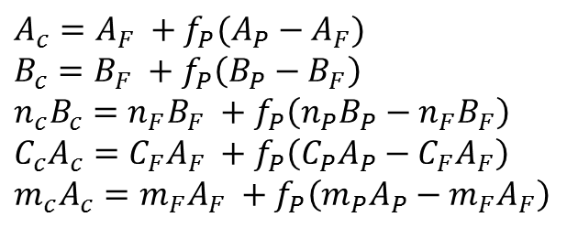
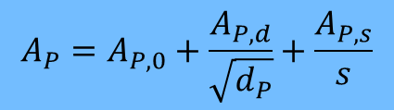
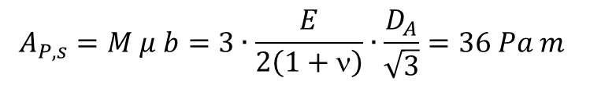
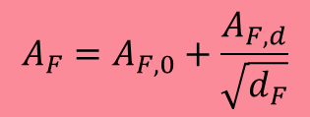



Microstructure-based material law
Johnson-Cook material law:
$$A_{c}=A_{F} +f_{P}(A_{P}−A_{F})$$
$$B_{c}=B_{F} +f_{P}\left(B_{P}−B_{F}\right)$$
$$n_{c}B_{c}=n_{F}B_{F} +f_{P}\left(n_{P}B_{P}−n_{F}B_{F}\right)$$
$$C_{c}A_{c}=C_{F}A_{F} +f_{P}\left(C_{P}A_{P}−C_{F}A_{F}\right)$$
$$m_{c}A_{c}=m_{F}A_{F} +f_{P}\left(m_{P}A_{P}−m_{F}A_{F}\right)$$
Hall-Petch-Relation:
$$A_{F}=A_{F,0}+\frac{A_{F,d}}{\sqrt{d_{F}}}$$
$$A_{P}=A_{P,0}+\frac{A_{P,d}}{\sqrt{d_{P}}}+\frac{A_{P,s}}{s}$$
$$A_{F,0}=28 MPa$$
$$A_{P,0}=576 MPa$$
$$A_{P,s}=M μ b=3∙\frac{E}{2\left(1+ν\right)}∙\frac{D_{A}}{\sqrt{3}}=36 Pa m$$
$$A_{F,d}=18 MPa \sqrt{mm}$$
$$A_{P,d}=18 MPa \sqrt{mm}$$
Grade | f_{P} / % | d_{F} / µm | d_{P} / µm | s / nm | A / MPa | B / MPa | n / - | C / - | m / -
Pure Ferrite | 0 | variable | - | - | variable | 405 | 0.15 | 0.037 | 0.900
Pure Pearlite | 100 | - | variable | variable | Variable | 432 | 0.25 | 0.037 | 0.950
45CG | 85 | 38 | 83 | 366 | 644 | 428 | 0.24 | 0.037 | 0.949
45R | 60 | 24 | 83 | 293 | 515 | 421 | 0.21 | 0.037 | 0.944
45WB | 60 | 22 | 83 | 687 | 474 | 421 | 0.21 | 0.037 | 0.944
45GP* | 50 | 50 | 50 | 1230 | 397 | 418 | 0.20 | 0.037 | 0.943

Slide 2
Computed flow curves from the microstructure
45CG – 5000 1/s
Experiment
Material law
45R – 5000 1/s
45WB – 5000 1/s
45GP – 5000 1/s
45CG – 0.5 1/s
45R – 0.50 1/s
45WB – 0.50 1/s
T = 20 °C
45GP – 0.50 1/s

